Slide 1
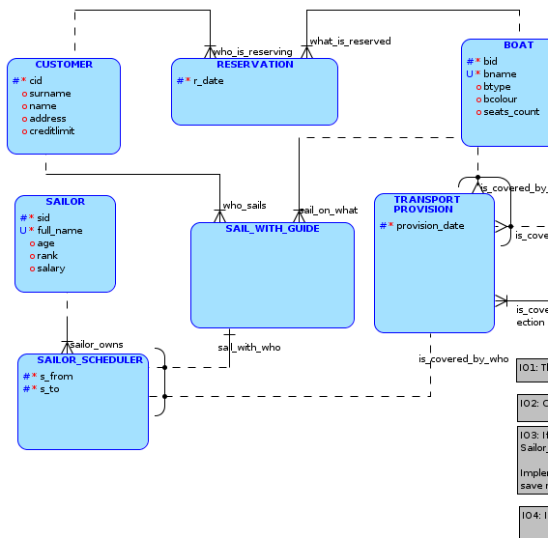
Lecture 2
Conceptual modelling

Slide 2
Conceptual modelling
Data view levels
Motivation – why conceptual model?
Suitable approaches for Information System (IS) design from the database point of view
The object oriented IS design
Conceptual model fragments => Entities (classes), relations (associations), attributes
ER model
Partiality
Identification dependency, weak entity
M:N relationship decomposition
Recursive relationship
ISA hierarchy

Slide 3
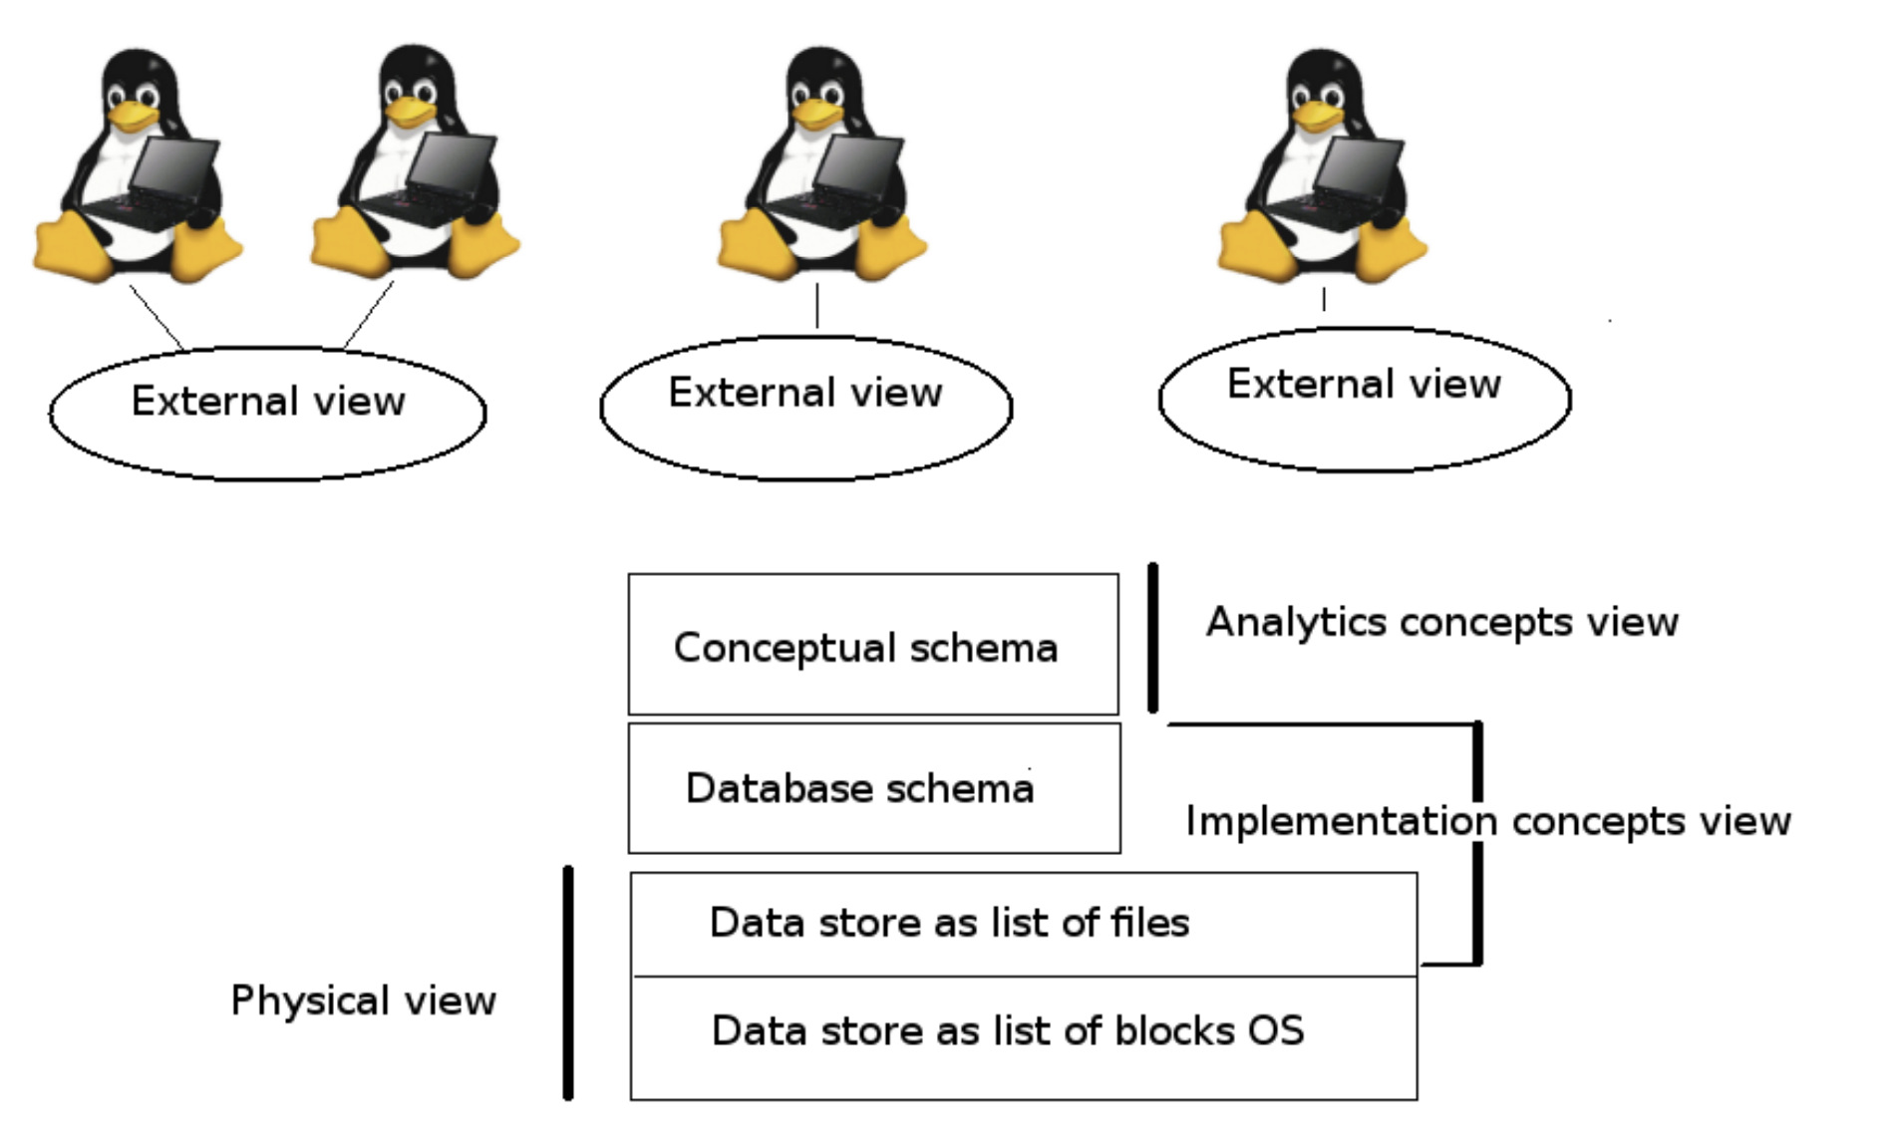

Different levels of view on the data
???
In fact, all you need is a towel!

Slide 4
Conceptual, Logical, Physical
Conceptual:
Cares about modeling of reality, Should Not be influenced by the future implementation. Usually the graphical representation (ER model, UML Class Diagram or others) is used.
Logical (Database):
Description of a portion of the database in a logical model (“views,” possibly in different models). We are using construction and queries tools (relational, object oriented, networks, hierarchical, XML...).
Physical:
Description of how data is stored physically (sequential files, indexes, clustered,...). Such users as software developers and common users are separated from it by database level.

Slide 5
Why databases conceptual model?
Main advantages:
Common understanding of the entities by users and developers.
Different users views integration.
The result is input for database construction.
It’s used as documentation.
Missing conceptual model consequences:
very low level point of view on the data:
problematic understanding with stakeholder (customer),
it is not possible to create (construct) bigger database.
it is not possible effectively oriented at the bigger database.

Slide 6
“old” approach for IS design
Function and data analysis are relatively split
Function schema – the result of functional analysis and design.
Who will use the database?– The system users categorization.
Organization operating procedures, how should be supported via computer IS.
Events description, which start operation procedure at organization and should be supported via computer IS.
Database schema – result of data analysis and design.
Problems: ensure functional and data analysis consistency.

Slide 7
The object oriented IS design
Functional and databases analysis are not strictly split, which ensures functional and data analysis consistency.
The object oriented approach allows data encapsulation, aggregation, composition, inheritance.
UML notation is object oriented.
UML (class diagram) has a lot of functionalities (close to the real world ). At the opposite side, the transformation into relational layer is not so easy as from binary ER model. During this subject we will use binary ER notation.

Slide 8
Conceptual model fragments
Entities and relations (associations) between them:
entity (classes), instances (objects) attribute:
data domain, mandatory (not NULL), identifier /unique
relations (associations):
associations cardinality,
partiality,
identifying relation (weak entity, strong entity),
ISA – hierarchy (subtypes).

Slide 9
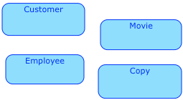
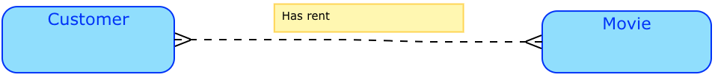
Data model design
Entities (entities subtypes) identification as classes of objects of identical data type.
Entity example: Movie, Customer, Employee, Copy… etc
Identification of relations between for entities:
Relation example: Customer (entity) - Has rent (relation) - Movie (entity)
It is an identification of attributes which describe entities and relations.

Slide 10
Attributes and IC(Integrity Constraint)
Examples of attributes:
surname (attribute) of employee (entity),
birth certificate number (attribute) of employee (entity),
date (relation attribute) till which has customer (entity) rent (relation) the copy of movie (entity).
Relation restriction examples (IC):
Attribute domain weight (customer entity) is integer.
Attribute weight (customer entity) must have only one value (for one customer).
Attribute birth certificate number is customer entity’s primary identifier.
Attribute date (of rent relation) can have maximally one value.
Attribute actor of movie entity can have multi values.

Slide 11
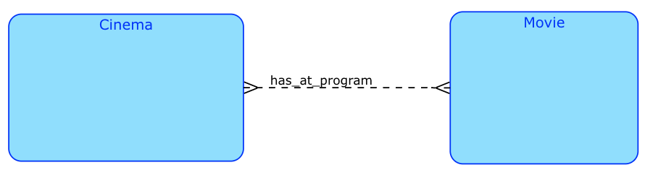
Entity and relation
We distinguish between written and graphic form:
Written form:
Entity: Cinema, Movie
Relation: has_at_program (Cinema, Movie)
Graphical form:
Note: we will mostly use binary ER notation (Oracle tool Data Modeller)

Slide 12
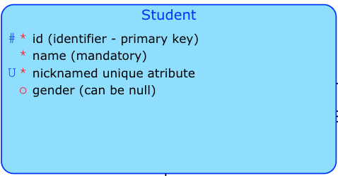
Attributes

Slide 13
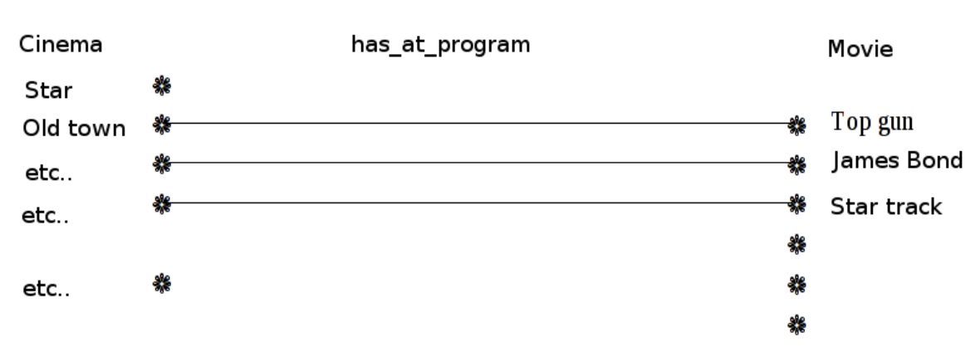
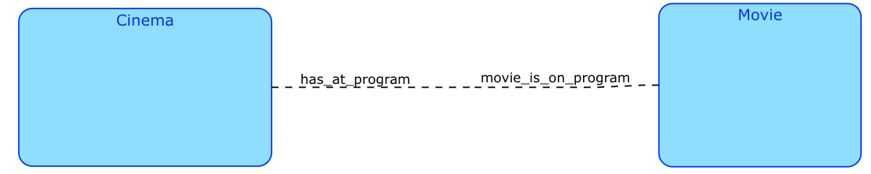
Cardinality 1:1
Cinema shows maximally one movie.
Move is at the program of maximally one cinema
Note: obligation/non-obligation of partiality in a relationship will be discussed later

Slide 14
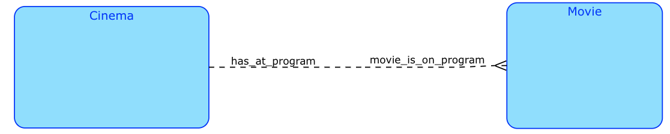
Cardinality 1:N
Cinema can show more movies.
The movie is shown at the program of maximally one cinema.

Slide 15

Cardinality M:N
Cinema can show more movies.
The movie can be shown at the program of many cinemas.

Slide 16

Participation in the relationship (partiality)
Mandatory participation (usually full line or “1“):
All instances must be connected to the relationship.
Cinema has to have at least one movie on the program.
Movie has to be at least on one cinema program.
Optional participation (usually dashed line or “0“):
Each instances can, but does not have to be connected to the relationship.
Cinema does not have to have a movie on the program.
(We can register a cinema without movie)
We can register movies which are not on the program of any cinema.
(Movie does not have to be on a program.)

Slide 17
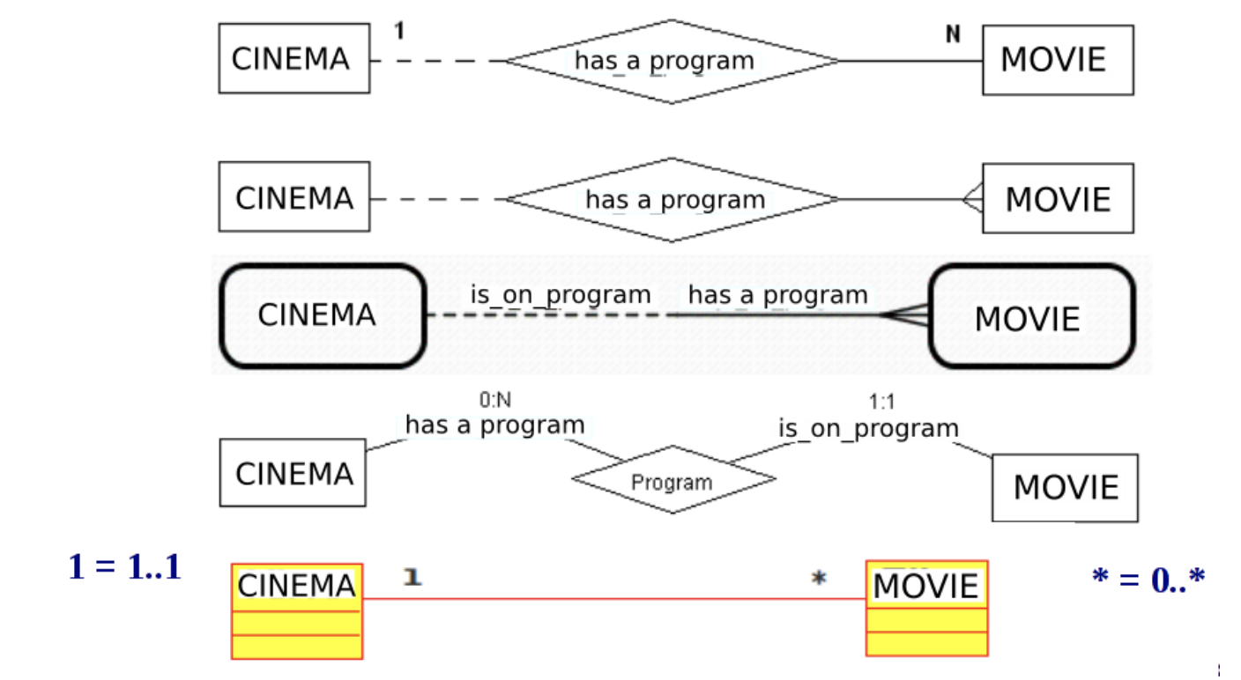
1:N - Optional participation – different notations
Cinema can have more movies on the program (or none).
Movie is on the program of exactly one cinema.

Slide 18
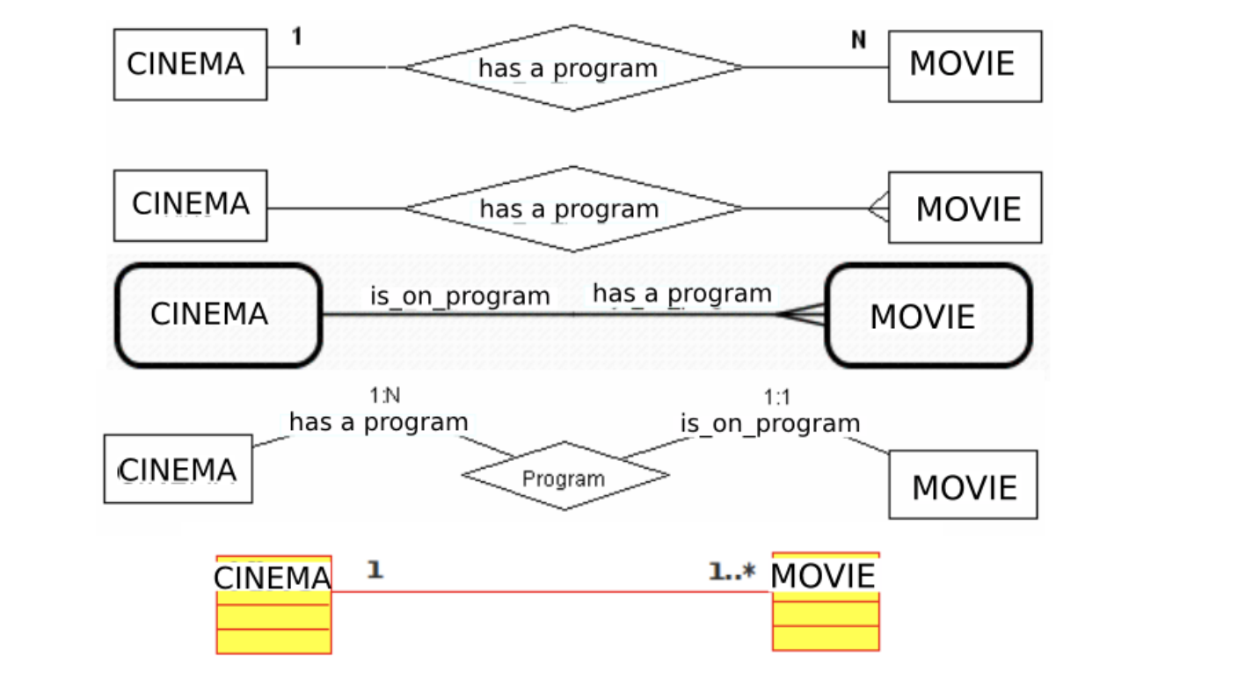
1:N - Mandatory participation – different notations
Cinema has to have at least one movie on the program (or many).
Movie is on the program of exactly one cinema.
How do we initialize such database?

Slide 19
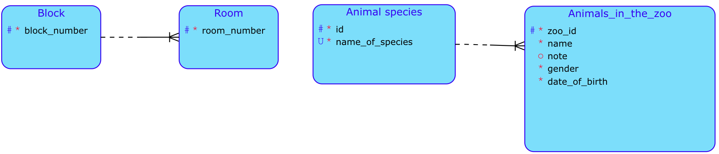
Identification dependency, weak entity
Entity is identified (partially or totally) by the relationship to another entity (entities).
Weak entity has its own attribute (room_number, zoo_id) which is a part of (compound) identifier (block_number, id) => PK of weak entity Room = block_number,room_number
Situation 1: A weak entity has its own attribute(room_id,zoo_id) involved in identification. In this case, the cardinality may be 1:N

Slide 20
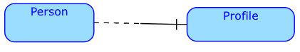
Identification dependency, weak entity
Situation 2: The weak entity does not have its own attribute that contributes to identification. In this case, the relationship may have a cardinality of only 1:1. At most one identification dependent may belong to one owner instance.
Each person may have at most one profile.

Slide 21
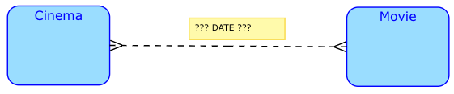
Attributes in relationship – motivation
Chen’s notation allows to introduce attributes in relationship.
Binary notation (and also UML Class Diagram) requires explicit relationship decomposition to introduce attributes to relationship.

Slide 22
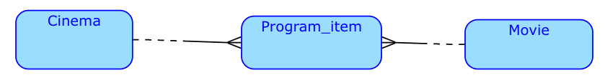

M:N relationship decomposition
Each M:N relationship can be decomposed into 2 1:N relationships. Either we provide strong entity:
or we can use identification dependency (on both strong entities):

Slide 23
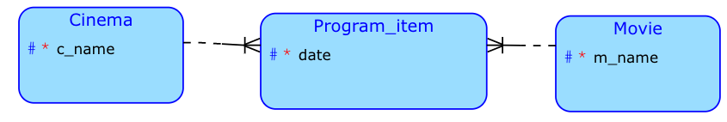
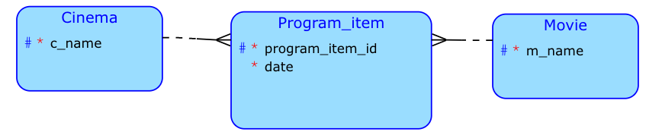
Attributes in relationship – solution
IDs of strong entities become the Primary Key of the weak entity
Using identification dependency:
Using strong entity and (artificial) identifier:
In this case the entity IDs will be used as foreign keys (they will not be part of the Primary Key)

Slide 24
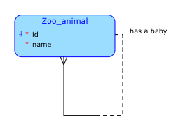
Recursive relationship
Is used to express relationship between two instances of the same entity. Direct supervisor, parent-child, component-part, ...
The crow's foot symbol says that this entity will have a different parent record ID (ID) key. We often call it by the relationship - it has a child id. There will be an intergrid constraint (IC) saying that the child ID must always be greater than the parent.

Slide 25
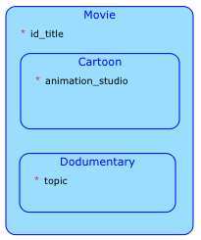
ISA hierarchy
Shortcut of ”Is a“ Careful, in strict ER modeling there is a requirement that exactly one sub-type instance of each super-type instance exists.
⇒ not suitable for roles (i.e. person - student/teacher, ...), identification dependency is better solution for this case.

Slide 26
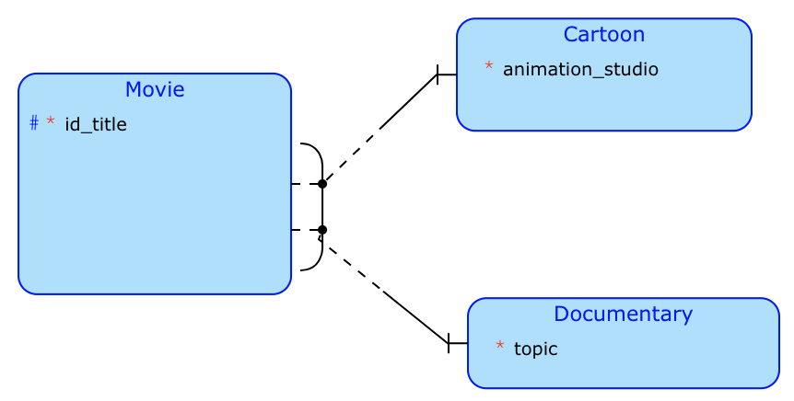
ISA hierarchy decomposition
You should be careful… ISA decomposition look like that (the relationships are in the ISA diagram hidden, but still exists).
There should only ever be one (N) film to type relationship (cartoon XOR documentary) at any one time. But it is not possible for a movie to be a cartoon and a documentary at the same time. Technically this is possible, but here it is ruled out by the session crossing symbol of the XOR function.

Slide 27
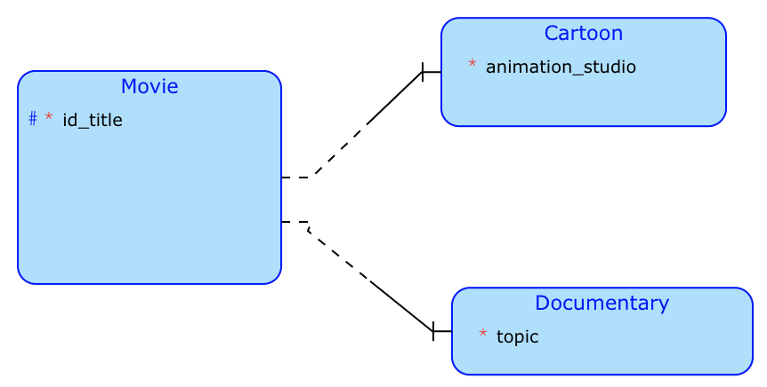
This it not ISA
In this usable for specialization
At this point it is possible for the movie to be a cartoon and documentary at the same time. There is no XOR symbol.

Slide 28
You should remember
The notations can be different. In conceptual modelling we are mainly concerned with the description of reality, not a solution in a concrete db machine.
We use entity relationships, cardinality and partiality not foreign keys.
Once foreign keys appear in the "picture" , it is no longer a conceptual, but a graphically presented relational schema.
SQL*Developer uses the following concepts:
logical model = conceptual schema - it is blue (which is what this lecture was about)
relational model = relational schema - it is yellow

